Slide 1
ETL, Delta Lakes and Layers
Submitted By
Maimoona Khilji

Slide 2
Content
ETL tools
What are ETL tools?
Need of an ETL tool?
Types of ETL tools?
Enterprise Software ETL Tools
Open-Source ETL Tools
Cloud-Based ETL Tools
Custom ETL Tools
What are Delta lakes?
What is Data Staging layer?
What is Data Curation layer?
What is Data presentation layer?

Slide 3
ETL tools
ETL is a data integration process that combines data from multiple data sources into a single, consistent data store that is loaded into a data warehouse or other unified data repository. ETL provides the foundation for data analytics and machine learning work streams.
ETL tools are software designed to support ETL processes:
extracting data from disparate sources,
transforming data for consistency and quality
consolidating this information into data warehouses.
If implemented correctly, ETL tools simplify data management strategies and improve data quality by providing a standardized approach to intake, sharing, and storage.

Slide 4
Need of an ETL tool?
Here are some ways in which an ETL tool can help your business grow:
Time-Efficiency:
An ETL tool allows you to collect, transform, and load data in an automated way. As a result, you can save plenty of time and effort otherwise spent on importing data manually.
Handle Complex Data Easily:
With time, your business will have to work with a vast amount of complex and diverse data. If you have to manage a range of attributes, you may end up formatting data all day long. An ETL tool streamlines the tedious data cleansing tasks for you.

Slide 5
Need of an ETL tool?
Reduced Error Probability:
Even if you are careful with your data, you are prone to errors when handling it manually. A slight mistake in the early stages of the data processing can be dicey. Why? Because one error leads to another mistake, and the cycle continues. For example, if you enter sales data incorrectly, your entire calculations can go wrong.
ETL tools automate several parts of a data process, reducing manual intervention and lowering error probability.
Improved Business Intelligence And ROI:
An ETL tool helps ensure data governance. As a result, you can use this high-quality data to make better decisions and increase your ROI.
Notes:
ROI: Return on investment (ROI)

Slide 6
Types of ETL Tools
On the basis of infrastructure and supporting organization, ETL tools are grouped into four categories. These categories are:
Enterprise Software ETL Tools
Open-Source ETL Tools
Cloud-Based ETL Tools
Custom ETL Tools

Slide 7
Enterprise Software ETL
Enterprise software ETL tools are developed and supported by commercial organizations. These solutions tend to be the most robust and mature in the marketplace.
This includes offering GUIs for architecting ETL pipelines, support for most relational and non-relational databases, and extensive documentation and user groups.
Though they offer more functionality, enterprise software ETL tools will typically have a larger price tag and require more employee training and integration services to onboard due to their complexity.
Top enterprise ETL tools are:
IBM DataStage
Oracle Data Integrator
Fivetran
SAS Data Management

Slide 8
Open-Source ETL Tools
Many ETL tools today are free and offer GUIs for designing data-sharing processes and monitoring the flow of information. A distinct advantage of open-source solutions is that organizations can access the source code to study the tool's infrastructure and extend capabilities.
However, open-source ETL tools can vary in upkeep, documentation, ease of use, and functionality since they are not usually supported by commercial organizations.
Top Open source ETL tools are:
Talend Open Studio
Pentaho Data Integration
Singer
Hadoop
Notes:
With the rise of the open-source movement, it’s no surprise that open-source ETL tools have entered the marketplace.

Slide 9
Cloud-Based ETL Tools
Cloud service providers (CSPs) offer ETL tools built on their infrastructure. A specific advantage of cloud-based ETL tools is efficiency.
Cloud technology provides high latency, availability, and elasticity so that computing resources scale to meet the data processing demands at that time. If the organization also stores its data using the same CSP, then the pipeline is further optimized because all processes take place within a shared infrastructure.
A drawback of cloud-based ETL tools is that they only work within the CSP's environment. They do not support data stored in other clouds or on-premise data centers without first being shifted onto the provider's cloud storage.
Top cloud-based ETL tools are:
Dataddo
AWS Glue
Azure Data Factory
Google Cloud Dataflow
Notes:
Following the widespread adoption of cloud and integration-platform-as-a-service technologies, cloud service providers (CSPs) now offer ETL tools built on their infrastructure.

Slide 10
Custom ETL Tools
Companies with development resources may produce proprietary ETL tools using general programming languages. Popular languages for building ETL tools include SQL, Python and Java.
The key advantage of this approach is the flexibility to build a solution customized to the organization's priorities and workflows.
The largest drawback of this approach is the internal resources required to build out a custom ETL tool, including testing, maintenance, and updates. An additional consideration is the training and documentation to onboard new users and developers who will all be new to the platform.

Slide 11
Delta lakes
Delta lake is an open source storage layer that brings reliability to data lakes which is a centralized repository that allows you to store all your structured and unstructured data at any scale.
Delta Lake runs on top of your existing data lake and is fully compatible with Apache Spark APIs. Delta Lake on Azure Databricks allows you to configure Delta Lake based on your workload patterns.
Azure Databricks adds optimized layouts and indexes to Delta Lake for fast interactive queries.
Azure Databricks is a data analytics platform optimized for the Microsoft Azure cloud services platform.

Slide 12
Delta lakes offers
Offers | Description
ACID transactions on Spark | Serializable isolation levels ensure that readers never see inconsistent data.
Scalable metadata handling | Leverages Spark distributed processing power to handle all the metadata for petabyte-scale tables with billions of files at ease.
Streaming and batch unification | A table in Delta Lake is a batch table as well as a streaming source and sink. Streaming data ingest, batch historic backfill, interactive queries all just work out of the box.
Schema enforcement: | Automatically handles schema variations to prevent insertion of bad records during ingestion.
Time Travel | Data versioning enables rollbacks, full historical audit trails, and reproducible machine learning experiments.
Upserts and Deletes: | Supports merge, update and delete operations to enable complex use cases like change-data-capture, slowly-changing-dimension (SCD) operations, streaming upserts, and so on.

Slide 13
Data Staging layer
A staging layer consists of selected structured data that is transformed before being loaded to the data warehouse in a pre-defined format.
Compared to schema on read used by the data lake, the staging layer uses a schema on write approach (ie, applying structure to the data as it is written), otherwise known as ETL (extract-transform-load), where business logic and transformations are developed prior to loading and are updated when needed.
A staging layer provides a closed off area for the loading and processing of source data, and is used as a workspace for subsequently applying transformations including complex calculations, data cleansing, and change data capture, before the data is loaded to the data warehouse for analysis.
A staging area, or landing zone, is an intermediate storage area used for data processing during the extract, transform and load (ETL) process. The data staging area sits between the data source(s) and the data target(s), which are often data warehouses, data marts, or other data repositories.

Slide 14
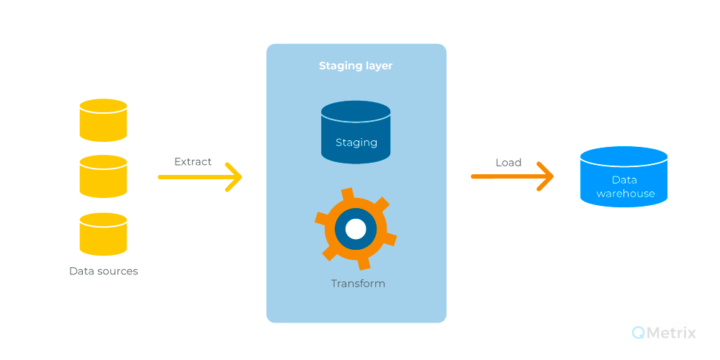
Data Staging layer

Slide 15
Steps in Data Staging layer
The following steps take place in Data Staging Layer.
Data Extraction
The Data received by the Source Layer is feed into the Staging Layer, where the first process that takes place with the acquired data is extraction.
Landing Database
The extracted data is temporarily stored in a landing database. It retrieves the data once the data is extracted.
Staging Area
The Data in Landing Database is taken, and several quality checks and staging operations are performed in the staging area.
The Structure and Schema are also identified, and adjustments are made to data that are unordered, thus trying to bring about a commonality among the data that has been acquired.
Having a place or set up for the data just before transformation and changes is an added advantage that makes the Staging process very important. It makes data processing easier.
Notes:
Step #1: Data Extraction
The Data received by the Source Layer is feed into the Staging Layer, where the first process that takes place with the acquired data is extraction.
Step #2: Landing Database
The extracted data is temporarily stored in a landing database.
It retrieves the data once the data is extracted.
Step #3: Staging Area
The Data in Landing Database is taken, and several quality checks and staging operations are performed in the staging area.
The Structure and Schema are also identified, and adjustments are made to data that are unordered, thus trying to bring about a commonality among the data that has been acquired.
Having a place or set up for the data just before transformation and changes is an added advantage that makes the Staging process very important.
It makes data processing easier.
Step #4: ETL
It is an Extraction, Transformation, and Load.
ETL Tools are used for the integration and processing of data where logic is applied to rather raw but somewhat ordered data.
This data is extracted as per the analytical nature that is required and transformed to data that is deemed fit to be stored in the Data Warehouse.
After Transformation, the data or rather information is finally loaded into the data warehouse.
Some examples of ETL tools are Informatica, SSIS, etc.

Slide 16
Steps in Data Staging layer
ETL
It is an Extraction, Transformation, and Load.
ETL Tools are used for the integration and processing of data where logic is applied to rather raw but somewhat ordered data.
This data is extracted as per the analytical nature that is required and transformed to data that is deemed fit to be stored in the Data Warehouse.
After Transformation, the data or rather information is finally loaded into the data warehouse.
Some examples of ETL tools are Informatica, SSIS, etc.

Slide 17
Data Curation layer?
Data curation is the process of creating, organizing and maintaining data sets so they can be accessed and used by people looking for information.
It involves collecting, structuring, indexing and cataloging data for users in an organization, group or the general public.
Your curated layer is your consumption layer. It's optimized for analytics, rather than data ingestion or processing. The curated layer might store data in de-normalized data marts or star schemas.
Some of the major examples of data curation services are data profiling, data management, data lineage, data disposal, data assurance, etc.

Slide 18
Data Curation layer?
Steps in a Data-Curation Workflow
Documenting the data.
Asking questions.
Translating into open formats.
Assessing FAIRness.
Cleaning and validating

Slide 19
Data presentation layer
Data Presentation Layer
This Layer where the users get to interact with the data stored in the data warehouse.
Queries and several tools will be employed to get different types of information based on the data.
The information reaches the user through the graphical representation of data.
Reporting Tools are used to get Business Data, and Business logic is also applied to gather several kinds of information.
Meta Data Information and System operations and performance are also maintained and viewed in this layer.

Slide 20
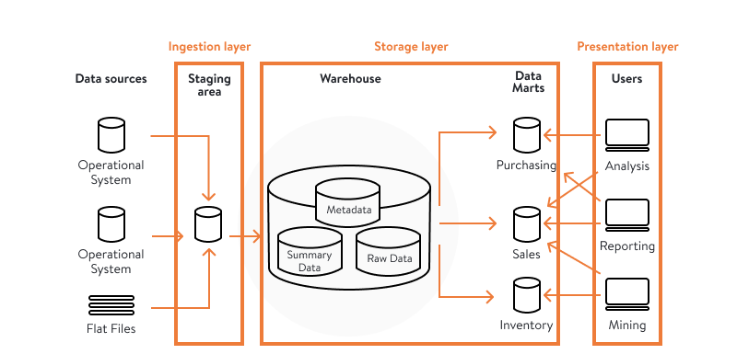
Data presentation layer

Slide 21
References
https://blog.hubspot.com/website/etl-tools
https://www.astera.com/type/blog/what-is-etl-tool/
https://docs.microsoft.com/en-us/azure/databricks/delta/delta-intro
https://qmetrix.com.au/data-lake-vs-staging-layer-difference/#:~:text=A%20staging%20layer%20provides%20a,the%20data%20warehouse%20for%20analysis.

Slide 22
THE END

